Slide 1


Internet of Things Essentials
DUAL AXIS SOLAR TRACKING SYSTEM
Team Members:
1. YASHVANTH NG (210701319)
2. VISHAL D (210701313)
3. VIMAL K B (210701309)

Slide 2
AGENDA
ABSTRACT
EXISTING SYSTEM
PROPOSED SYSTEM
OBJECTIVE
SYSTEM ARCHITECTURE
SIMULATION DIAGRAM
LITERATURE SURVEY
1. KEY CHALLENGES
2. MOTIVATION
MODULES
CONCLUSION AND FUTURE ENHANCEMENTS
REFERENCES

Slide 3
ABSTRACT
A dual axis solar tracking system utilizing Arduino technology provides an efficient and cost-effective means of maximizing solar energy absorption for photovoltaic panels or solar thermal collectors. The system employs two motors, one for horizontal (azimuth) movement and the other for vertical (elevation) adjustment, allowing the solar panel to follow the sun's trajectory across the sky for optimal energy capture. Here the analog signals are analyzed and controlled by Arduino Uno. The energy obtained from the sun is collected using a solar panels and the movement of the servo motors which moves the panel to the direction where more energy is available.By maintaining the panel perpendicular to the sun's rays, the system enhances energy output, improves efficiency, and can reduce overall energy costs. The implementation of such a system demonstrates the potential for smarter, more sustainable solar energy solutions.

Slide 4
EXISTING SYSTEM
In the numerous studies Solar Tracker is used to track the sunlight for producing energy in the form of sunlight. In the paper titled “Single Axis Solar Tracking System Using Arduino” by A Kulkarni which is the base paper for our project. In the existing system it consists of a microcontroller, sensors, voltage regulator, driver circuit, dc geared motor, and solar panel frame axis. Here the sensors are arranged in such a way that the solar panel rotates in only one degree of freedom. When the sun travels from east to west, the sun’s highest position also changes. Hence this system is only helpful in tracking either of the axes. Therefore, the output energy is also not ideal.

Slide 5
PROPOSED SOLUTION
The Dual-axis solar tracking system that tracks the maximum sun rays using LDR sensors. This block diagram is designed according to track solar rays in both axes all day. The system includes a power supply, Arduino, two servo motors, four LDR sensors, battery, charge controller, and solar panel. This total system is designed in a form so that it tracks the sun efficiently and obtains maximum solar energy from the sun and increases the output efficiency and provides better performance even in cloudy conditions. The power supply is given to Arduino. The LCD is also powered by the Arduino. The analog information is transferred from LDRs to Arduino. According to the Arduino program, instructions are given to the servo motors and these motors eventually provide movement to the solar panel.

Slide 6
OBJECTIVES
Maximize Solar Energy Harvesting: Continuously adjust the angle and orientation of solar panels to capture maximum sunlight throughout the day, optimizing energy production.
Energy Efficiency: Improve overall energy conversion efficiency by precisely tracking the sun’s position and adapting panel angles accordingly.
Scalability: Design the system to be scalable and adaptable for various solar installations, from residential to commercial or industrial applications.

Slide 7
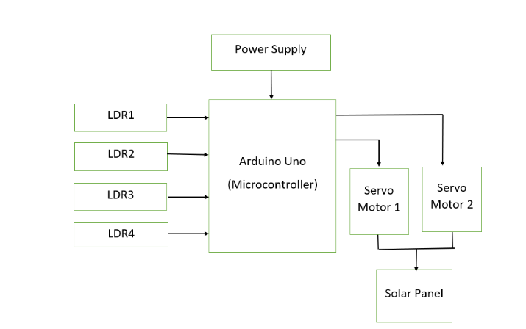
SYSTEM ARCHITECTURE

Slide 8
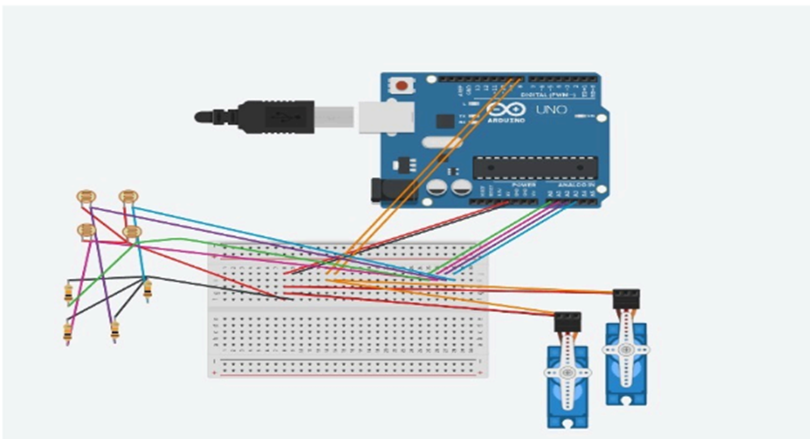
SIMULATION DIAGRAM

Slide 9
LITERATURE SURVEY
SL.NO | NAME OF THE PAPER | AUTHOR | YEAR
1. | Single Axis Solar Tracking System Using Arduino | A Kulkarn | 2021
2. | Wind and Solar Power Systems Design, Analysis and Operations | M. R. Patel | 2019
3. | A Low cost single-axis sun tracking system using PIC microcontroller | Kais I. Abdul-lateef, | 2020
4. | Enhanced energy extraction in an open loop single-axis solar tracking PV system with optimized tracker rotation about tilted axis." | Khan, Rafid Adnan, Rezwanul Mahmood. M, and Anisul Haque | 2018
5. | A novel backtracking approach for two-axis solar PV tracking plants | Fernández-Ahumada, L. M, Ramírez-Faz. J, López-Luque. R, M. VaroMartínez, Moreno-García. I. M., and Casares de la Torre. F. | 2020

Slide 10
KEY CHALLENGES
Accurate Tracking to capture maximum sunlight throughout the day, optimizing energy production.
Ensuring the system's moving parts and sensors remain in good working condition for long-term use can be complex.
Balancing the power consumption.
Protecting the system from cyber threats.
Variations in weather, such as strong winds, heavy rain, or snow, can impact the system's performance and require robust design and protection.

Slide 11
MOTIVATION
The project ”Dual axis solar tracking system” aims to develop an automated setup designed to optimize solar energy capture by adjusting the orientation of solar panels to follow the sun's movement across the sky. Utilizing an Arduino microcontroller, the system receives input from light-dependent resistors (LDRs) that measure sunlight intensity from different directions. Based on this data, the Arduino sends signals to two servo motors, which control the azimuth and elevation angles of the solar panels. This precise adjustment allows the panels to maintain a perpendicular position relative to the sun throughout the day, maximizing energy production. The system enhances efficiency, increases The energy yield, and reduces the need for manual intervention, providing a cost-effective and sustainable solution for solar energy harvesting.

Slide 12
MODULES
Arduino UNO board x 1
Solar panel x 1
SG90 servo motor x 1 -
LDR sensor x 2
10k resistor x 2
Jumper wires
Rigifoam / Foam board / Cardboard

Slide 13
MODULES
Arduino UNO board x 1:
The Arduino UNO is a microcontroller board based on the ATmega328P, featuring 14 digital input/output pins, 6 analog inputs, a 16 MHz quartz crystal, a USB connection, a power jack, an ICSP header, and a reset button, making it ideal for beginners and advanced users to create interactive projects.
Solar panel x 1:
A solar panel is a device that converts sunlight into electrical energy, typically composed of numerous photovoltaic cells.
SG90 servo motor x 1:
The SG90 servo motor is a compact, lightweight actuator commonly used in hobbyist robotics and control systems, capable of precise angular movement typically up to 180 degrees.
LDR sensor x 2:
LDR sensors, or Light Dependent Resistors, are components that change their resistance based on light intensity, typically used in light sensing and detection applications.

Slide 14
MODULES:
10k resistor x 2:
Two 10k resistors are passive electrical components, each with a resistance of 10,000 ohms, used to limit current and divide voltages in electronic circuits.
Jumper wires:
Jumper wires are electrical wires with connector pins at each end, used to connect components on a breadboard or other prototyping setup without soldering.
Rigifoam / Foam board / Cardboard:
Rigifoam, foam board, or cardboard are versatile, lightweight materials often used for crafting, model-making, and creating structural prototypes in various projects.

Slide 15
CONCLUSION
The proposed system is a highly effective solution for maximizing solar energy harvesting by continuously adjusting the orientation of solar panels to follow the sun's path across the sky. This system offers increased energy production and efficiency by maintaining optimal angles for solar exposure throughout the day and across seasons. By using sensors like LDRs and components such as SG90 servo motors, dual-axis tracking systems enable precise, automated panel positioning, thereby enhancing the overall performance and return on investment of solar installations. This technology plays a crucial role in advancing sustainable energy solutions and can be applied to a range of solar projects, from residential rooftops to large-scale solar farms.

Slide 16
FUTURE ENHANCEMENT
Enhanced Sensor Technologies: Developing more advanced sensors (e.g., solar position sensors, infrared sensors) for better sun tracking and increased accuracy.
Integration of AI and Machine Learning: Utilizing AI and machine learning algorithms to optimize solar panel positioning based on historical data, weather forecasts, and current environmental conditions.
Advanced Materials: Exploring the use of lightweight and durable materials for the construction of tracking systems to reduce wear and tear and enhance longevity.

Slide 17
REFERENCES
[1] M. R. Patel, Wind and Solar Power Systems Design, Analysis and Operations, 2nd Edition, CRC Press Taylor & Francis Group Producing a PCB.n.d., BocaRaton,2019.
[2] Kais I. Abdul-lateef, A Low cost single-axis sun tracking system using PIC microcontroller, Diyala Journal of Engineering Sciences, Vol. 05, No. 01, pp.65-78, June 2020.
[3] Design and Implementation of a Sun Tracker with a Dual-Axis Single Motor “Jing-Min Wang and Chia-Liang Lu’’,2020.
[4] Khan, Rafid Adnan, Rezwanul Mahmood. M, and Anisul Haque. "Enhanced energy extraction in an open loop single-axis solar tracking PV system with optimized tracker rotation about tilted axis." Journal of Renewable and Sustainable Energy 10, no. 4 (2018).
[5] Fernández-Ahumada, L. M, Ramírez-Faz. J, López-Luque. R, M. VaroMartínez, Moreno-García. I. M., and Casares de la Torre. F. "A novel backtracking approach for two-axis solar PV tracking plants." Renewable Energy 145 (2020).

Slide 18
Thank You

